Slide 1
HTML-introduction
Basic of the HTML files

Slide 2
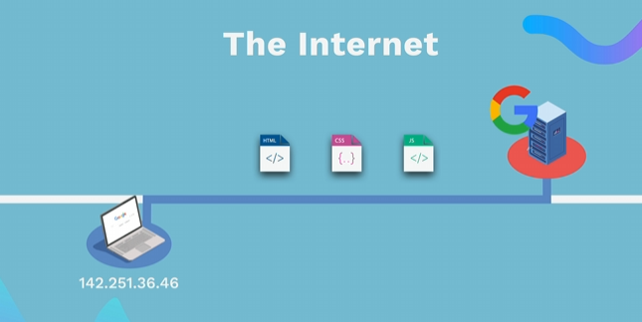
HOW WEBSITES WORK
👉 HTML (Content) - The structure of a web page (text, images, buttons). 👉 CSS (Styles) - Defines the layout (colors, fonts, arrangement of elements). 👉 JavaScript (Functionality)- Adds interactivity (click events, animations, form validation). The browser interprets and displays these files to display the web page.
Notes:
• Emphasize that HTML is mandatory for any web page and serves as the structural foundation on which CSS and JavaScript build design and interactivity. • Open with a discussion on how browsers parse these three components to render a complete webpage. • Consider demonstrating a simple “Hello World” HTML file in Visual Studio Code with Live Preview.
Resources: • https://developer.mozilla.org/en-US/docs/Web/HTML for a thorough introduction. Additional Reading: • HTML and CSS: Design and Build Websites by Jon Duckett • Learning Web Design: A Beginner’s Guide to HTML, CSS, JavaScript, and Web Graphics by Jennifer Niederst Robbins

Slide 3
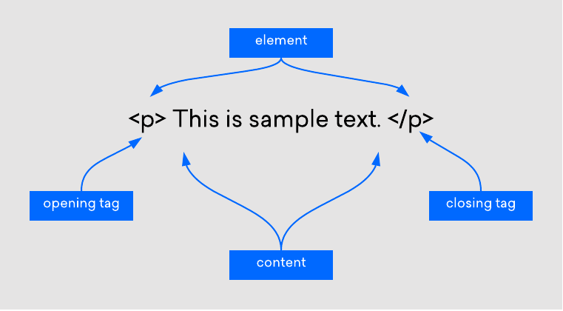
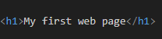
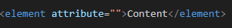
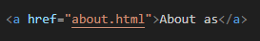
HTML
💡 Unlike CSS or JavaScript, a website can only exist with an HTML file 👉 Markup language: Similar to editorial markup in manuscripts (bold, underline, etc.) 👉 HTML uses tags to structure content
Notes:
Teacher Notes: • Clarify that while CSS and JavaScript enhance user experience, HTML is indispensable for content. • Use side-by-side examples to show a page with only HTML versus one with additional CSS and JavaScript. • Discuss how changes in each part (structure, style, behavior) affect the final rendered page.
Resources: • MDN – Introduction to HTML - https://developer.mozilla.org/en-US/docs/Learn_web_development/Core/Structuring_content/Basic_HTML_syntax Additional Reading: • HTML and CSS: Visual QuickStart Guide by Elizabeth Castro

Slide 4
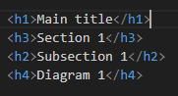
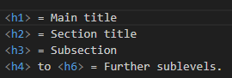
HTML TITLES

Slide 5
• MDN – Introduction to HTML - https://developer.mozilla.org/en-US/docs/Learn_web_development/Core/Structuring_content/Basic_HTML_syntax • HTML and CSS: Visual QuickStart Guide by Elizabeth Castro

Slide 6
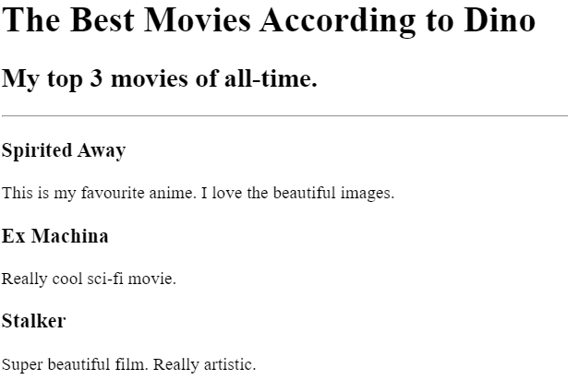
HTML TITLES – EXERCISE 1
💡 Install in VS code and use the Live Preview plugin to view changes in real-time 👉 Recreate image
Notes:
Teacher Notes: • Demonstrate setting up VS Code with the Live Server extension to observe changes instantly. • Explain the role of the <title> tag not only in SEO but also in user navigation (browser tabs). • Walk through creating an HTML document that uses a proper <head> section including a title.
Resources: • MDN – Using the HTML <title> element
Code - https://github.com/dinoDuvnjak/CTK/tree/main/SHIFT4IT/html-introduction/2.6-html-final

Slide 7
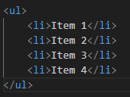
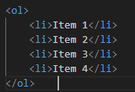
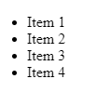
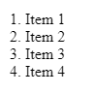
HTML LISTS
Unordered list
Ordered list
💡 It is used when the order is not important (e.g. shopping list).
💡 It is used when the order is not important (e.g. shopping list).
Notes:
Teacher Notes: • Stress the importance of correct syntax and indentation for both maintenance and readability. • Conduct a live coding session to show how HTML lists should be structured and highlight typical errors.
Resources: • MDN – HTML Lists • W3Schools – HTML Lists
Additional Reading: • Learning Web Design by Jennifer Niederst Robbins

Slide 8
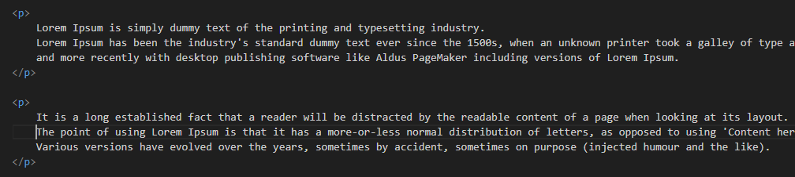
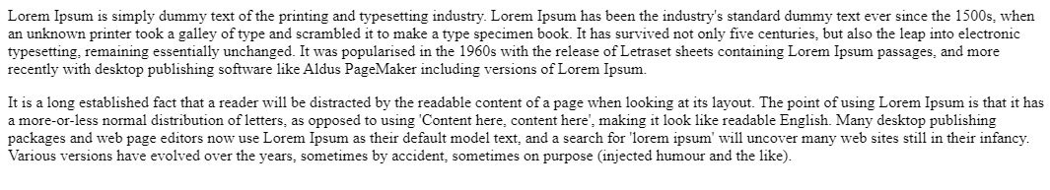
HTML PARAGRAF
💡 The paragraph element<p> is used to format the text into separate paragraphs 👉 Without <p> tags, all the text would be in one long block. 👉 It separates the text and adds visual spacing between paragraphs. 👉 Screen readers use <p> labels to help visually impaired users navigate through text
Notes:
Teacher Notes: • Illustrate how omitting <p> tags can lead to cluttered content and poor accessibility. • Discuss best practices in creating readable content that both sighted users and screen readers can navigate easily.
Resources: • MDN – HTML Paragraphs
Additional Reading: • Accessibility for Everyone by Laura Kalbag

Slide 9
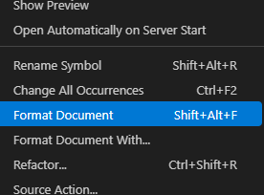
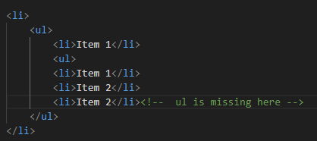
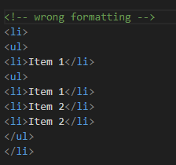
HTML LISTS
Common mistakes to avoid ❌ Forgetting to close tags (</ul> or </ol>).
❌ Incorrect code indentation, making it difficult to read and maintain.
❌ Setting </li> before closing a nested list instead of after it.

Slide 10
• MDN – HTML Paragraphs • Accessibility for Everyone by Laura Kalbag

Slide 11
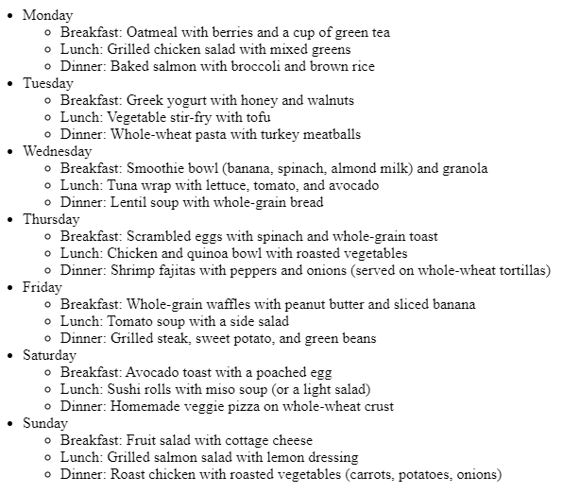
HTML LIST – EXERCISE 2
👉 Recreate image in html code
Notes:
Teacher Notes: • Guide students through the creation of nested lists and using proper list tags (<ul>, <ol>, <li>). • Offer step-by-step instructions while projecting the code and its rendered output.
Resources: • MDN – HTML Lists • W3Schools – HTML Lists
Code - https://github.com/dinoDuvnjak/CTK/tree/main/SHIFT4IT/html-introduction/2.2-html-list

Slide 12
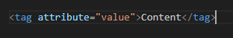
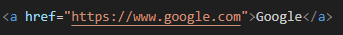
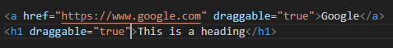
HTML ATTRIBUTES
💡 HTML elements can have attributes that add additional information about the element. 👉 Attributes are located inside the opening tag
https://www.w3schools.com/html/html_attributes.asp
Specific
Global
Notes:
Teacher Notes: • Explain that attributes add metadata or control behavior for HTML elements (e.g., href, src, alt). • Discuss how some attributes are available for all tags (global attributes) while others are tag-specific. • Encourage students to explore the provided link for interactive examples.
Resources: • W3Schools – HTML Attributes • MDN – HTML Standard Attributes
Additional Reading: • HTML5 in Easy Steps by Mike McGrath

Slide 13
HTML ANCHOR
💡 Allows the creation of hyperlinks 👉 The href attribute specifies the URL to which the link leads. Attributes are located inside the opening tag 👉 Without the href attribute, the link is not active
Notes:
Teacher Notes: • Demonstrate the creation of both internal and external links using relative and absolute URLs. • Highlight the importance of using descriptive link text for both SEO and accessibility.
Resources: • MDN – The HTML Anchor Element • W3Schools – HTML Links

Slide 14
HTML IMAGE
💡 Allows you to add images to our websites 👉 The src attribute (source) defines the source of the image 👉<img> It doesn't have a closing tag, because it's a void element.
Why is alt important? 👉 Helps blind and visually impaired people understand the content of the image. 👉 When an image can't load, alt text is displayed.
Notes:
Teacher Notes: • Emphasize best practices for image embedding and the critical role of the alt attribute in accessibility. • Show examples of responsive images and discuss troubleshooting steps if images do not load.
Resources: • MDN – The HTML <img> Element • W3Schools – HTML Images

Slide 15
• MDN – The HTML <img> Element • W3Schools – HTML Images
• MDN – The HTML Anchor Element • W3Schools – HTML Links
• W3Schools – HTML Attributes • MDN – HTML Standard Attributes • HTML5 in Easy Steps by Mike McGrath

Slide 16
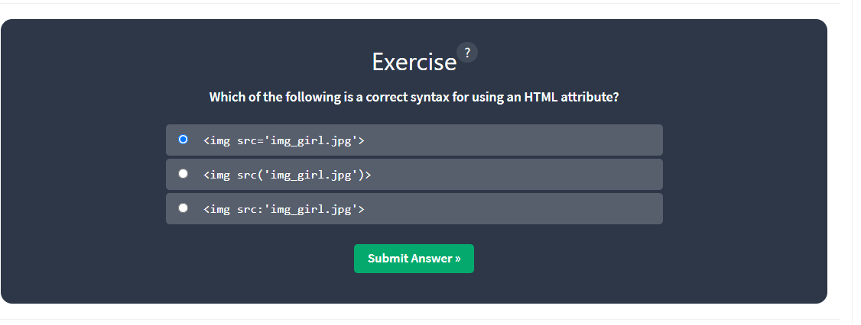
HTML ATTRIBUTES – EXERCISE 3
👉 Go to ://www.w3schools.com/html/html_attributes.asp and practice the quiz
Notes:
Teacher Notes: • Briefly review common pitfalls with attributes in class after the exercise. • Encourage students to modify attributes and observe changes in real-time using a code editor.
Resources: • W3Schools – HTML Attributes

Slide 17
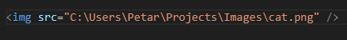
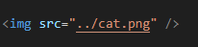
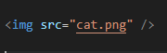
HTML PATHS
💡 A file path is a unique location on your computer where a specific file or folder is located. 👉 We can compare it to a real-world address
Absolute path
Relative path
One level up
Current directory
Notes:
Teacher Notes: • Use examples to illustrate the differences between absolute and relative paths. • Demonstrate navigation using relative path syntax in linking files locally.
Resources: • MDN – URLs, URIs, and URNs • W3Schools – How Paths Work
Additional Reading: • Responsive Web Design with HTML5 and CSS3 by Ben Frain

Slide 18
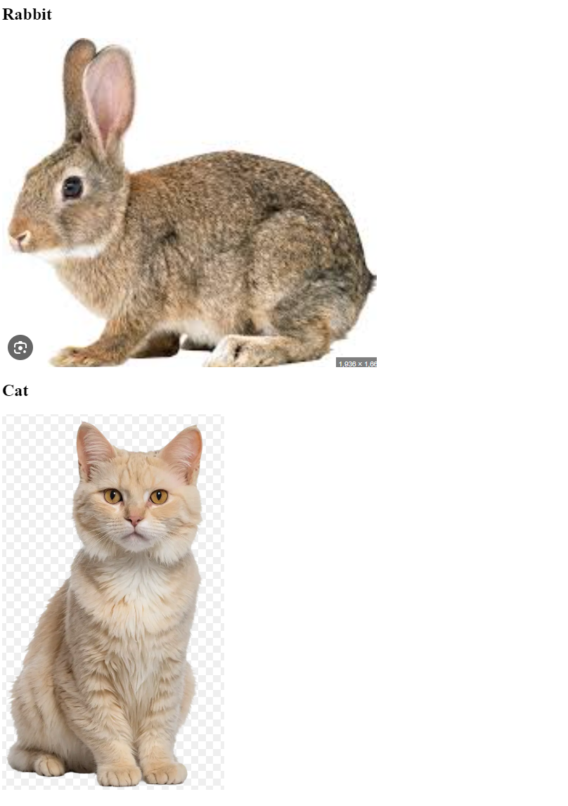
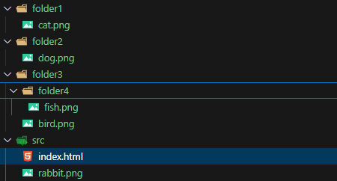
HTML IMAGES – EXERCISE 4
👉 Download 2.4-html-image-link project and connect the images in html file
👉 Replicate the image result
Notes:
Teacher Notes: • Walk through the process of linking local images and discuss troubleshooting common issues like incorrect file paths or typos. • Offer to review a sample project live, explaining the impact of each attribute used in the <img> tag.
Resources: • W3Schools – HTML Images Tutorial • MDN – The HTML <img> Element
Code - https://github.com/dinoDuvnjak/CTK/tree/main/SHIFT4IT/html-introduction/2.4-html-image-link

Slide 19
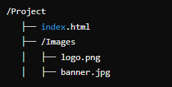
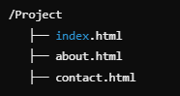
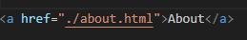
HTML MULTIPAGE
💡 To allow users to navigate through the site, we need to link pages using hyperlinks.
One page website
Multipage website
How to link a page
💡 Allows you to add images to our websites 👉 ./ means "search in the current directory". 👉 By clicking on the link, we will be taken to the "About Us" page.
Notes:
Teacher Notes: • Demonstrate linking multiple HTML files to create a navigable website. • Emphasize the importance of organizing files and folders for maintainability. • Use a live coding example to show how clicking a link opens a new page.
Resources: • MDN – Linking to Other Resources • W3Schools – HTML Links
Additional Reading: • Head First HTML and CSS by Elisabeth Robson and Eric Freeman

Slide 20
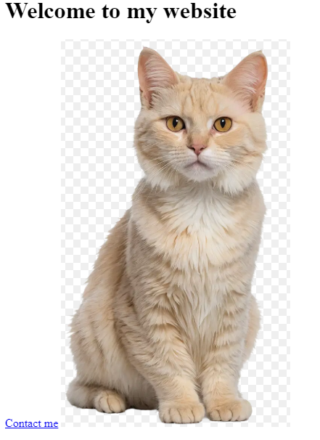
HTML LINKS – EXERCISE 5
Create a multi-page site 👉 Clicking on the image takes us to the about us page 👉 Click on Contact me, take us to the contact page
Notes:
Teacher Notes: • Provide clear guidelines and a rubric for the exercise. • Encourage students to test all navigation links to ensure there are no broken paths. • Review best practices for organizing and maintaining consistent navigation across pages.
Resources: • Codecademy – Building Multi-Page Websites (project-based learning) • MDN – Hyperlink Fundamentals
Code - https://github.com/dinoDuvnjak/CTK/tree/main/SHIFT4IT/html-introduction/2.5-html-multipage-website

Slide 21
MDN – Linking to Other Resources W3Schools – HTML Links
Additional Reading: Head First HTML and CSS by Elisabeth Robson and Eric Freeman
Codecademy – Building Multi-Page Websites (project-based learning) • MDN – Hyperlink Fundamentals

Slide 22
HTML – FINAL EXERCISE
HTML Task: Create a Basic CMS for a Classroom
Objective: Create a basic HTML skeleton for a Classroom Management System. The goal is to create a foundation that will later be enhanced with CSS and JavaScript. Once completed, upload the project to GitHub.
✅ Requirements: ✔️ Create a valid HTML skeleton ✔️ Include header, navigation, form, table, and footer ✔️ Add at least two sample students ✔️ Code should be clean and properly indented ✔️ Upload the project to GitHub
Notes:
Teacher Notes: • Clearly lay out project requirements and milestones. • Provide a sample file structure and tips on ensuring clean, indented code. • Encourage peer reviews and code sharing via GitHub to promote collaborative learning. • Highlight the importance of version control in web development.
Resources: • GitHub Guides – Hello World for an introduction to Git and GitHub • FreeCodeCamp – HTML Project Tutorials for project-based learning
Code- https://github.com/dinoDuvnjak/CTK/tree/main/SHIFT4IT/html-introduction/2.6-html-final

Slide 23
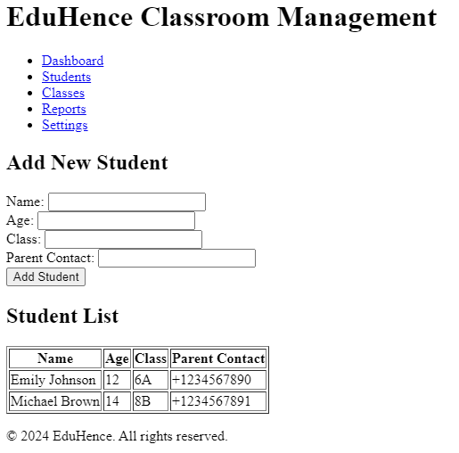
HTML – FINAL EXERCISE
Notes:
Teacher Notes: • Clearly lay out project requirements and milestones. • Provide a sample file structure and tips on ensuring clean, indented code. • Encourage peer reviews and code sharing via GitHub to promote collaborative learning. • Highlight the importance of version control in web development.
Resources: • GitHub Guides – Hello World for an introduction to Git and GitHub • FreeCodeCamp – HTML Project Tutorials for project-based learning
Code- https://github.com/dinoDuvnjak/CTK/tree/main/SHIFT4IT/html-introduction/2.6-html-final

